Slide 1
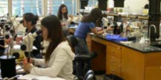


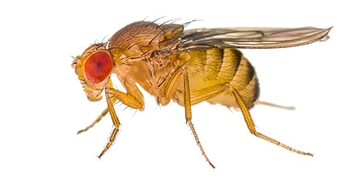
Biomedical Research 10H (BR10H)
Genes, Genetics, and Genomes (6 units)
Course Description
This course is an introduction to the exciting world of scientific research. Whether you are curious about scientific research or already have an established interest in how the research world works, this is the right course for you! We use molecular genetics and the fruit fly, Drosophila melanogaster, to explore the function of genes. Research using the fly allows us to employ powerful genetic tools in a cost-effective and timely manner, and is of significant relevance to human biology. The work you will do is not just a series of experiments that are meant to teach methods and competencies at the lab bench, but rather are done as part of a current, large-scale, scientific project that spans multiple academic quarters. The data students produce is used and analyzed for course writing assignments, and is ultimately compiled and developed into a manuscript suitable for publication in a peer-reviewed scientific journal article.
In BR10H you’ll learn about:
Cancer and stem cell biology
Science Communication
skills
Laboratory techniques
Molecular Biology
Data Analysis
Genetics
Fruit flies as a model organism
Research careers
Dissections
and Microscopy
All students welcome!
No prior research experience necessary!
BR10H serves as a prerequisite for application to the Minor in Biomedical Research
Lectures held 3:30-4:45pm Monday/Wednesday
Lab sections held 9-11:50am or 1-3:50pm Tuesday/Thursday
Questions? Contact
Dr. Carrie Spratford
(spratford@ucla.edu)
Apply to the Fall ‘23 or Winter ‘24 quarter of BR10H here:
https://www.biomedresearchminor.ucla.edu/biomedical-research-10h-application/

