Slide 1

Guidelines for Using the Behavioral Testing Core at UCLA

Slide 2

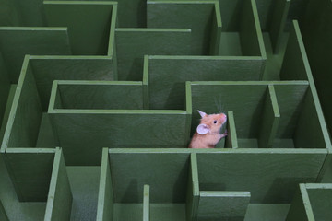
Welcome to the BTC!
We are happy to assist in all your behavioral testing needs
  Protocol setup and experimental design
  Personalized protocol or equipment modifications
  All training and troubleshooting
  Data analysis and interpretation

Slide 3
Currently Available Behavioral Assays
AnyMaze and Topscan Tracking capabilities
In vivo optogenetic integration
Affordable optogenetic ferrule implants

Slide 4
Introduction
We would like to keep the BTC a clean and efficient working environment for everyone
Each individual person working on a project must complete this course
  Be sure to follow proper booking procedures
  Follow the CLEANING and DISINFECTION protocols for the area and equipment you use, or you will lose your BTC privileges

Slide 5
Overview
Cleaning and Disinfection Protocols
Costs and Billing
Animal Housing & Disaster Plan
Publishing your paper- Don’t forget to mention us!
Scheduling and Calendars
Site Safety

Slide 6
Scheduling and Calendars

Slide 7

Scheduling & Calendars- Reservations
How much time should you reserve?
    Example for EPM with 20 mice: 30 min + (5 + 2 min)*20 mice +30 min= 200 min = book 3.5 hrs (round up to the nearest 15 min increment)
If you are unsure, please OVER estimate to avoid running late and into another users time slot
  After you finish, edit the calendar for ACTUAL usage time, for billing purposes
Animal acclimation time and equipment setup
(likely 30 min to 1 hr)
Assay duration
(i.e., 5 min for elevated plus maze)
Changeover between animals
(i.e., 2 min for cleaning and resetting the camera)
Cleanup and equipment takedown
(likely 15-30 min)

Slide 8

Scheduling & Calendars
  Our billing is based on self-reported use in the calendars.
  We are operating on the Honor System and expect our users to accurately record their usage times in the calendars.
  If we find repeated instances of intentional under-reporting, you will lose all privileges and access to BTC facilities.

Slide 9

Cancellation Policy
  Please try to cancel at least 24 h prior to the start of your reservation!
  We have limited space and equipment, and other users may be waiting for equipment or space to open up.
  If you fail to cancel at least 1 h prior to your reservation, you will be charged for your scheduled time.

Slide 10
Scheduling & Calendars- Summary
We will share calendar upon course completion
Reserve your time in the correct room
  Some equipment cannot be moved, and must be done in a specific room
  Moveable equipment can be used in any multi-purpose room
Use the title of the assay to name the reservation
  Add all equipment to be used as “accessories”
  Be sure to add a software dongle in “accessories”, if doing live tracking
  Select the correct billing code “self-performed”

Slide 11
  Cleaning and Disinfecting

Slide 12

Cleaning & Disinfecting
We would like to keep the BTC a clean and efficient working environment for everyone
Follow the CLEANING and DISINFECTION protocols for the area and equipment you use, or you will lose your BTC privileges
  After each use, complete the cleaning log provided in each room

Slide 13
Cleaning & Disinfecting
You are working in a SHARED facility, with many users
  To minimize the risk of cross contamination, the space and equipment must be sanitized before and after use with Strikebac (including carts)
  YOU ARE RESPONSIBLE FOR PROPER CLEANING
  If you find that a room or piece of equipment has not been properly cleaned by the previous user, REPORT this to BTC staff IMMEDIATELY

Slide 14
Cleaning & Disinfecting
REPEATED FAILURE TO PROPERLY CLEAN AND
DISINFECT ALL SURFACES AND EQUIPMENT
AFTER EACH USE
WILL RESULT IN LOSS OF ACCESS TO BTC FACILITIES

Slide 15
Daily Cleaning Protocol
Ensure room has been properly cleaned prior to bringing in animals
Wipe down all surfaces and equipment with Strikebac
Wipe down cart shelves with Strikebac
Bring in animals for acclimation
If it is not sufficiently clean, let BTC staff know immediately
In between each animal, clean with Strikebac or 70% Ethanol
This will depend on the “risk level” of your animals, as well as behavior protocols

Slide 16
Daily Cleaning Protocol
After testing is complete, return animals to their housing room
Wipe down all surfaces and equipment with Strikebac
Sweep the floors, disinfect with the spray mop, and place the trash can in the hallway
Record your name, the date and time in the cleaning log on the door
YOU ARE RESPONSIBLE FOR PROPER HANDLING AND DISPOSAL OF ANY MATERIALS YOU BRING INTO THE FACILITY, including sharps, controlled substances, and other chemicals
After disinfecting, disassemble equipment and put it back into the designated storage space

Slide 17
Daily Cleaning Protocol
Daily completion of the cleaning log is an
ARC requirement!
Failure to document your cleaning and
sterilization will result in an
ARC violation

Slide 18
Core Costs & Billing

Slide 19
Core Costs
Current Rates*
Service | Rate
Initial Consultation | FREE
Staff Supervised (training rate)** | $90/hr
Unsupervised (self-performed)*** | $55/hr
Staff-performed** | $115/hr
Statistical Analysis | $75/hr
Ferules for Optogenetic Implant | $20 each
*Rates are subject to change at any time
**Subject to $20/hr overtime charge for weekends and experiments lasting >8 hrs consecutively
***Discounts available for clients using >300 hr/yr; off-peak only

Slide 20
Monthly Billing
Billing is completed on a monthly basis
  Charges are based on self-reported use in the calendar, so accurate scheduling is critical!
Please acquire the FAU number that you would like to charge for billing PRIOR to taking the quiz
  You will be REQUIRED to provide your FAU # to pass the quiz at the end

Slide 21
Monthly Billing
REPEAT:
You will be REQUIRED to provide your FAU # to pass the quiz at the end

Slide 22
Animal Housing & Disaster Plan

Slide 23
Animal Housing
Your animals are housed and cared for in a DLAM-operated facility
  BTC staff are not responsible for arranging transfers, room assignments, or day to day care of any animals housed in Pritzker (formerly Franz) hall
All arrangements regarding animal transfers to/from Pritzker Hall Vivarium, room assignments, diet, etc can be directed to the vivarium manager
To gain badge access, contact the vivarium manager to schedule a walk-through
Current manager: Numan Interiano (ninteriano@mednet.ucla.edu)

Slide 24
Animal Disaster Plan
In the event of an emergency:
  All animals within the vivarium will be taken care of by DLAM personnel.
  They will make the decision to relocate or euthanize animals, if it becomes absolutely necessary.

Slide 25
Animal Disaster Plan
Please review the animal disaster plan prior to running your animals, in order to be prepared to take action as needed in the event of an emergency
The BTC office landline can be used to make emergency calls
  Once training is complete, all users will have off hours badge access to the BTC office
Remember to attend to your animals’ safety only if it is safe for you to do so

Slide 26
Site Safety

Slide 27
Site Safety
Please be sure to review all safety guidelines, the BTC approved ARC protocol, and cleaning SOPs prior to beginning your work
  General safety and user liability info can be found here:
    https://btc.psych.ucla.edu/user-guidelines/site-safety/
  BTC ARC protocol #2002-130-61can be found here:
    https://sites.lifesci.ucla.edu/btc/user-guidelines/arc-protocol/
    Password: uclabtcprotocol
  Cleaning SOPs can be found here:
    https://btc.psych.ucla.edu/user-guidelines/cleaning-and-disinfecting-protocols/

Slide 28


Site Safety
Upon your first visit, you must complete the Safety Equipment Identification Survey with a BTC staff member
  Locate all paths of egress from the building, fire extinguisher locations, and safety shower/eyewash stations
  First Aid kits are located in the BTC office
Remember to report all serious injuries to your immediate supervisor
Gloves and other PPE are available at the DLAM gown-up stations next to each vivarium
Do not use any BTC equipment without prior training from BTC staff

Slide 29
Publishing your paper-
Don’t forget to mention us!
  Please acknowledge the UCLA Behavioral Testing Core in any publications or posters that result from data collected here.
    For posters we have a BTC logo that you can use.
  Update us regularly regarding publications and posters so that we can maintain a list
    This is vital to show productivity and receive continued support in our department
  We do not require that the Behavioral Testing Core Supervisor and/or Staff be included as a co-author(s) on publications, but in some cases it may be warranted and/or advantageous to do so!
    Substantial involvement on our part in the development of novel behavioral tasks/experimental design for your project, statistical analysis/consultation, interpretation of behavioral results and/or assistance in writing any portion of the paper
    Having the Supervisor as a co-author can also help provide more credibility regarding behavioral expertise for labs whose expertise lie elsewhere

Slide 30

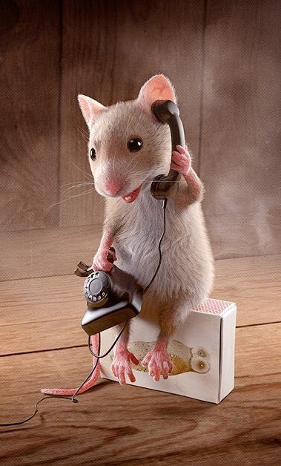
Feedback
Please feel free to speak to the Supervisor or Staff about any concerns, thoughts or comments regarding the BTC.
  This includes, but is not limited to: missing equipment, low supplies, broken or malfunctioning equipment, booking issues and ideas for improving the services we provide.
  If we don’t know about a problem, we can’t fix it!
We are constantly looking to improve and expand the services we provide so please feel free to discuss new tasks and equipment that could help meet your research needs!

Slide 31

Quiz
Congratulations! You have completed the tutorial for this course.
To receive credit for completion and to be added to the calendars and start booking your experiments, you must complete the quiz
  The password to start the quiz is: UCLABTC

Slide 32
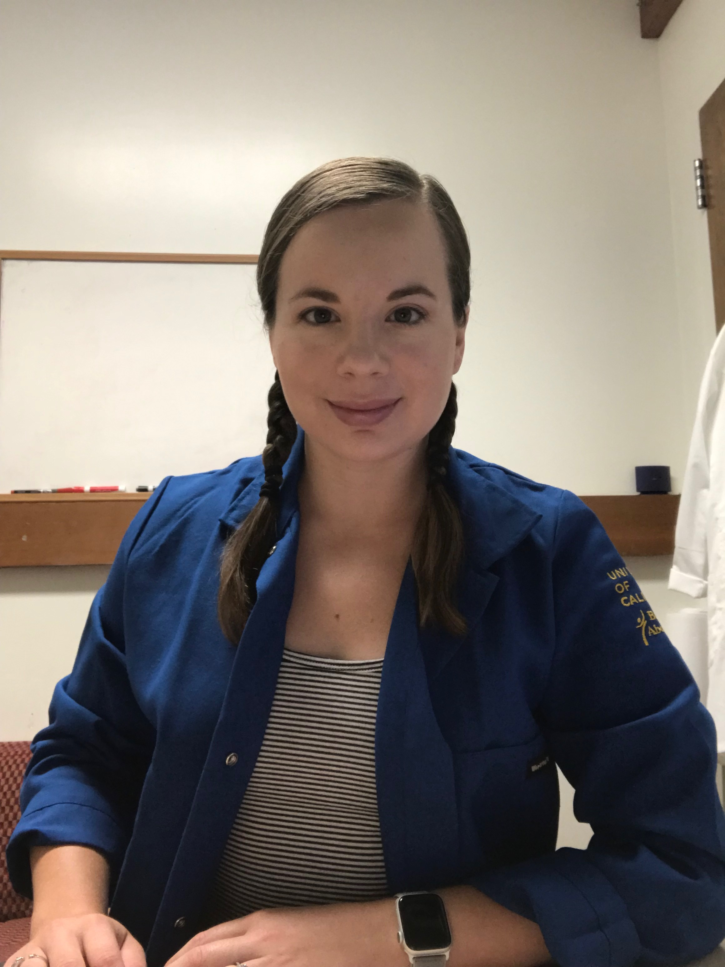
Contacts
Lindsay M Lueptow, PhD
UCLA Behavioral Testing Core, Supervisor
llueptow@psych.ucla.edu
Irina Zhuravka, BA
Behavioral Technician/Assistant Manager
irina.z.fanselowlab@gmail.com
Visit our website for more info: https://btc.psych.ucla.edu/
Email us: uclabtc@gmail.com or call: 310-267-4628

