Slide 1
Gel Scramble Lecture 1
William Grisham, Ph.D.
Copyright 2014

Slide 2
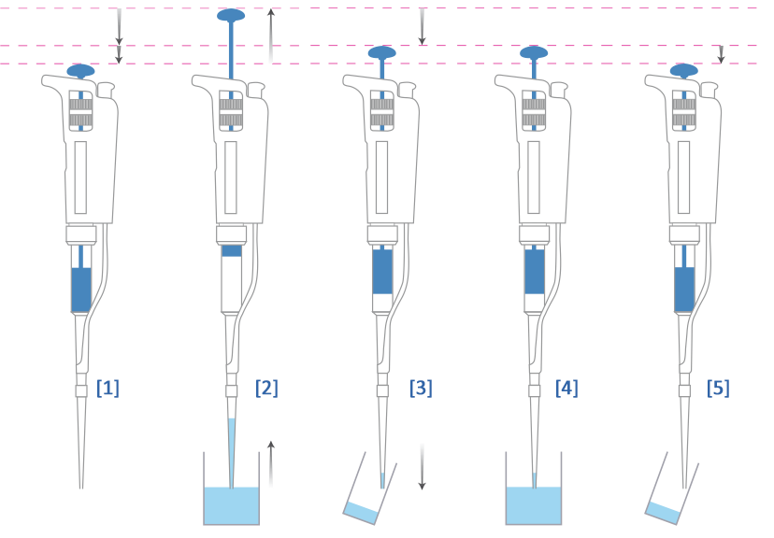
Notes:
From:
http://www.protocol-online.org/biology-forums-2/posts/26342.html

Slide 3
Pedagogical Goals
1) Enhanced critical thinking skills
2) Dealing with unexpected data
  50% of ALL experiments in science don’t “work”
  Having strategies to deal with unexpected data are important
    Unexpected data can reveal important discoveries
    Need to rule out alternative explanations first
    Explaining unexpected data can lead to good troubleshooting protocols

Slide 4
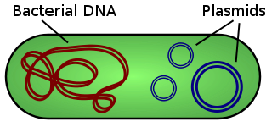
Plasmids allow for the cheap and
Easy replication of big pieces of DNA
Notes:
From
http://en.wikipedia.org/wiki/Plasmid

Slide 5
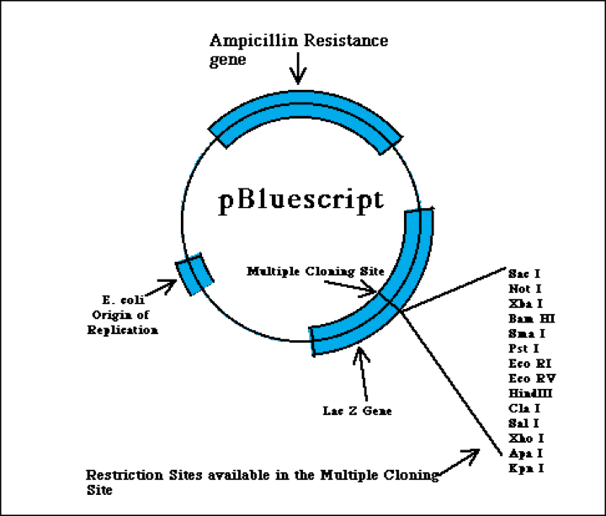
2961 Bp
Notes:
From
http://www.bio.davidson.edu/Courses/Molbio/MolStudents/spring2003/Keogh/plasmids.html#basicplasm

Slide 6
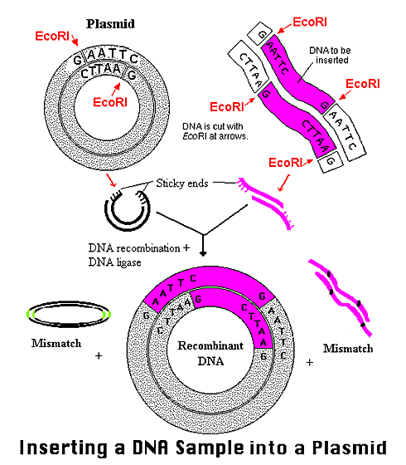
Notes:
From
http://www.bio.davidson.edu/Courses/Molbio/MolStudents/spring2003/Keogh/plasmids.html#basicplasm

Slide 7
PCR is another method to replicate DNA
Can only replicate smaller stretches of DNA—at present cannot replicate the sequence of entire genes
Silly PCR song
http://www.youtube.com/watch?v=x5yPkxCLads

Slide 8
Back to plasmids and endonuclease digests
Can amplify the DNA of interest by inserting it into a plasmid and then inserting the plasmid into bacteria—bacterial transformation
Could sequence the insert to confirm that it is the gene of interest OR
Do an endonuclease digest which is cheaper and easier

Slide 9
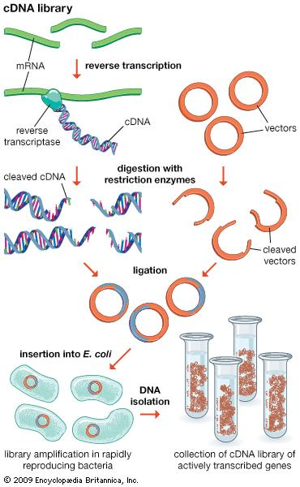
Notes:
From
http://media-1.web.britannica.com/eb-media/45/117845-004-7A5A589A.jpg

Slide 10
First Big Objective
Identify the gel that goes with a given insert
  First step is to take each gene+plasmid and determine the fragments expected from digestion via the protocols
  Need to use the info about the gene (reference number or sequence)
  Need to use information about the vector (plasmid)

Slide 11
Starting Materials
The vector, which is to say the plasmid—characteristics given in the manual
cDNAs for each of 6 mystery DNAs—Entrez gene reference numbers given in manual
The protocols from the website for enzymes used in digest https://mdcune.psych.ucla.edu/modules/gel

Slide 12
An example with steps
—not your digest, necesssarily
1) Take each mystery gene, and find out the restriction sites using NEBcutter.
2) Figure out the number of fragments and their size for use with a given digest.
3) Make a table for the expected values fro a given protocol.
4) Make a restriction map of the plasmid + insert identifying the base pair at which cuts could be expected.

Slide 13
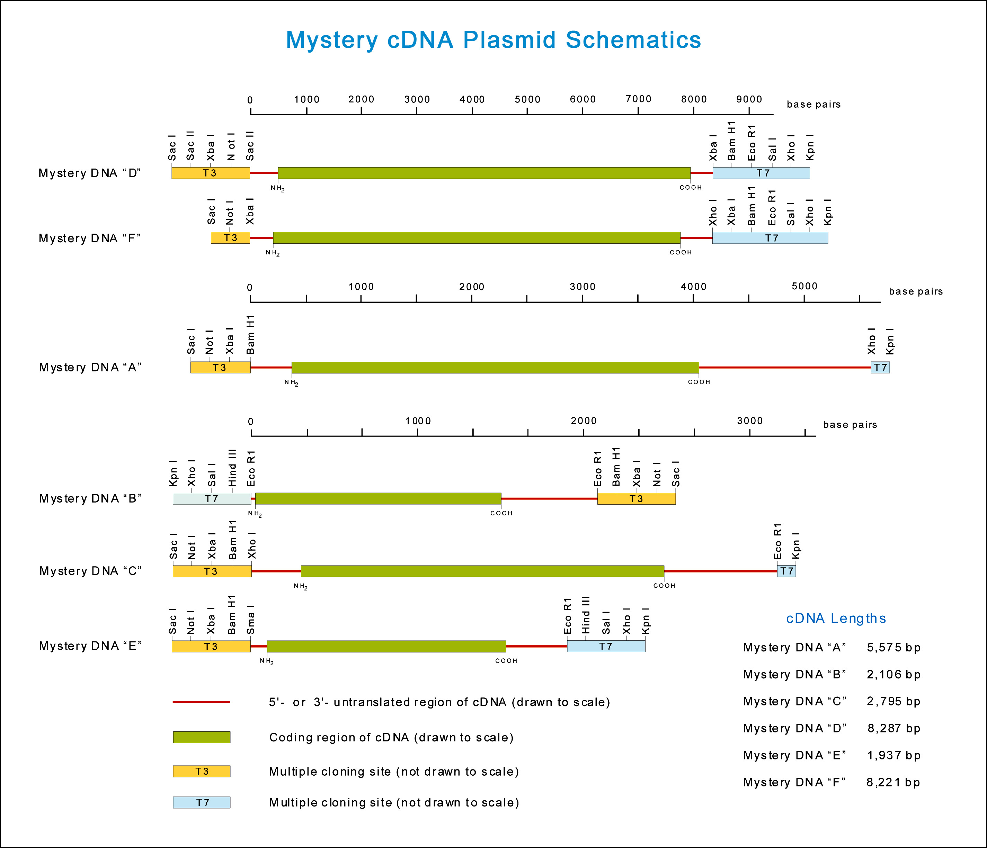

Slide 14
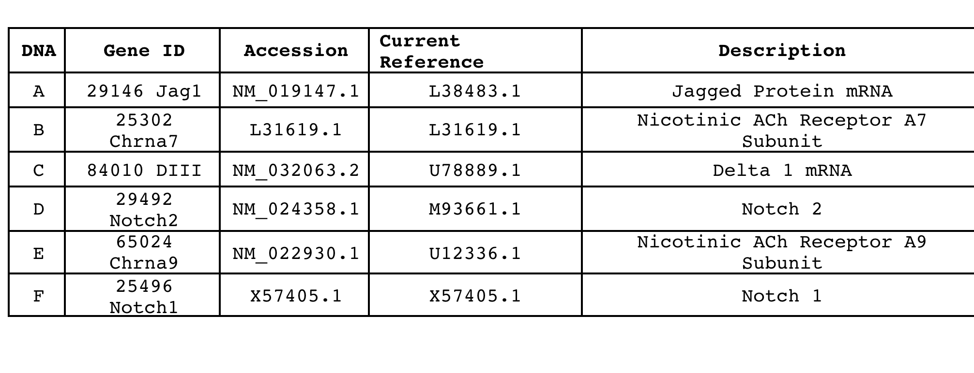

Slide 15
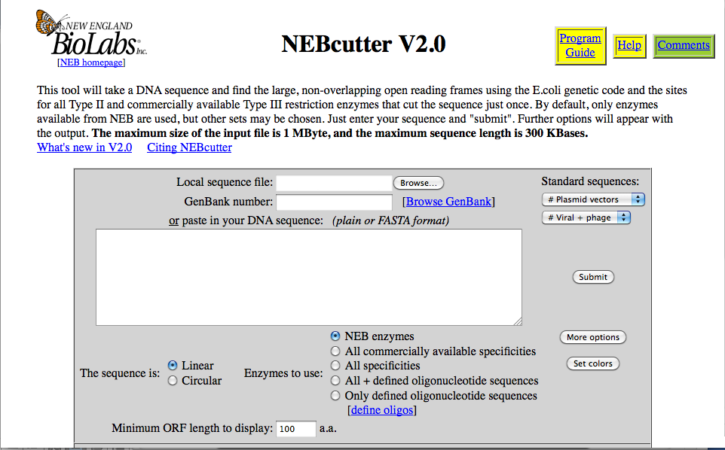
Paste genbank # here.
Or paste the sequence of
entire gene here.
Notes:
From
http://tools.neb.com/NEBcutter2/index.php

Slide 16
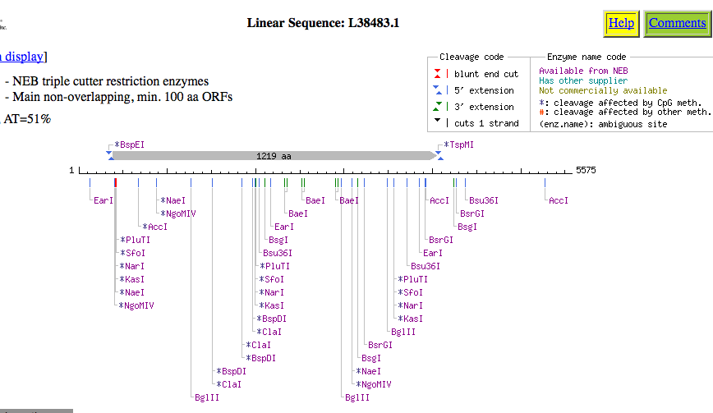
129
2174
3853
Notes:
From
http://tools.neb.com/NEBcutter2/index.php

Slide 17
129
2174
3853
Notes:
From
http://tools.neb.com/NEBcutter2/index.php

Slide 18
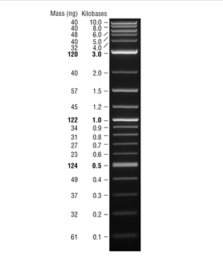
Notes:
From
https://www.neb.com/products/n3200-2-log-dna-ladder-01-100-kb

Slide 19
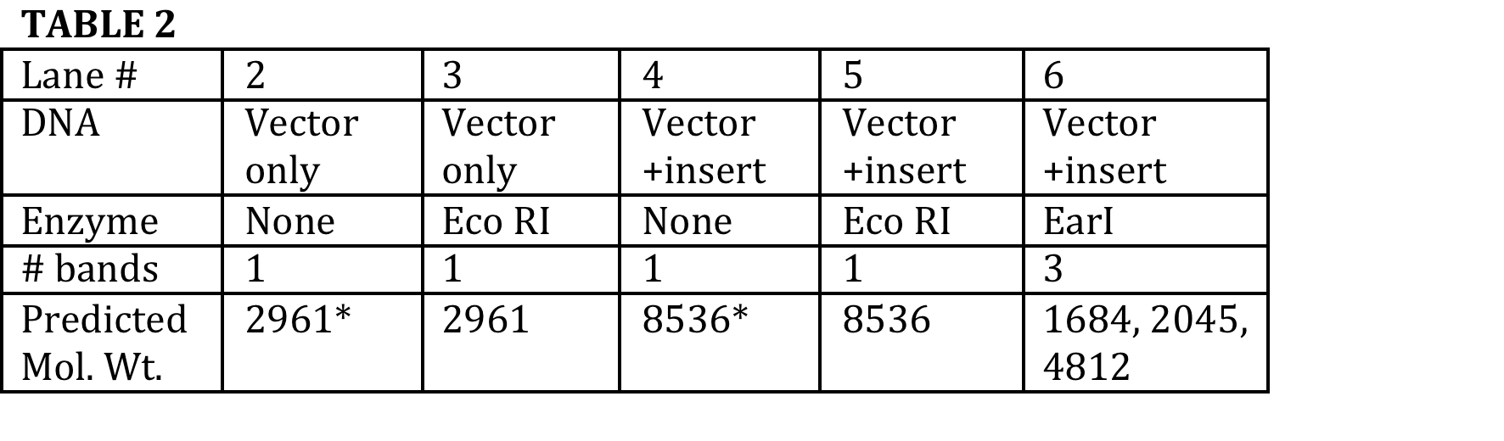
Predicted band size for made-up protocol for mystery DNA A—Jagged protein

Slide 20
129
2174
3853
Notes:
From
http://tools.neb.com/NEBcutter2/index.php

Slide 21
2961 Bp
Notes:
From
http://www.bio.davidson.edu/Courses/Molbio/MolStudents/spring2003/Keogh/plasmids.html#basicplasm

Slide 23
Where to get the protocols
Dr. G’s website
https://mdcune.psych.ucla.edu/modules/gel

Slide 24
Things that you need to accomplish in week 1 for your lab report
1) Make a table of the number of predicted fragments and their respective size for each 6 mystery cDNA protocols.
2) For each mystery cDNA, draw a map of where the various restriction endonuclease enzymes used in the protocol would have cut in the insert and in the vector (multiple cloning site)—insert should be to scale but the vector need not be.

Slide 25
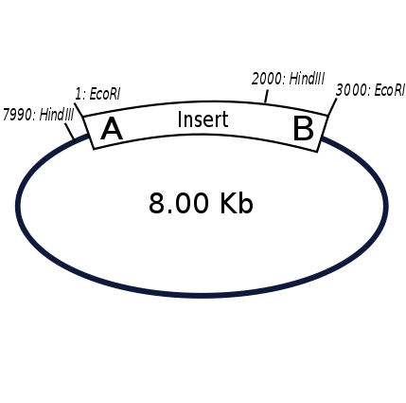
Notes:
From
http://en.wikipedia.org/wiki/Restriction_map

Slide 26
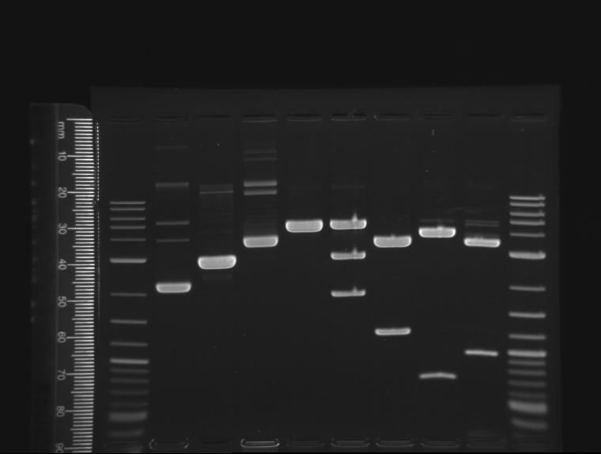
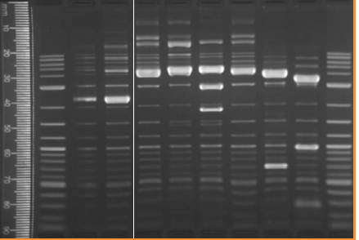
Expected
Challenge

Slide 27
Summary
1) Learned about plasmids and their inserts
2) Learned about using NEBcutter to make a restriction map of the inserts.
3) Learned how to put the information from NEBCutter with information about the plasmid vector to construct a table of the expected number of fragments and their size.

