Slide 1
Our Proteins
Jagged Protein
Nicotinic ACh Receptor A7 Subunit
Delta 1
Notch 2
Nicotinic ACh Receptor A9 Subunit
Notch 1

Slide 2
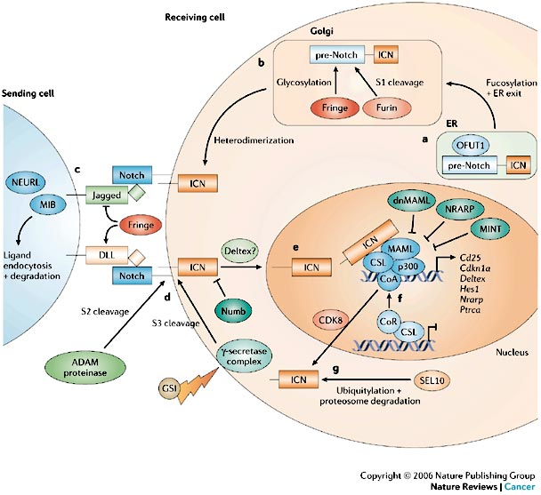
Jagged Protein
Notes:
From
http://www.nature.com/nrc/journal/v6/n5/fig_tab/nrc1880_F2.html

Slide 3
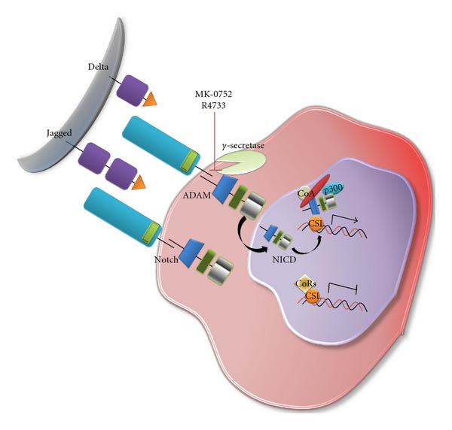
Notes:
From http://www.hindawi.com/journals/jo/2011/941876/fig4/
Notch is a transmembrane protein-Notch signaling promotes proliferative signaling during neurogenesis and its activity is inhibited by Numb to promote neural differentiation.-Once the cell with Delta contacts the Notch cell the piece inside breaks off and heads for the nucleus. What it does here is stop the cell from differentiating while the Delta cell remains able to do so.
Inhibits differentiation of the cell—Notch signaling in the retina favors the generation of Muller glia cells at the expense of neuronsalso plays a role in cancer

Slide 4
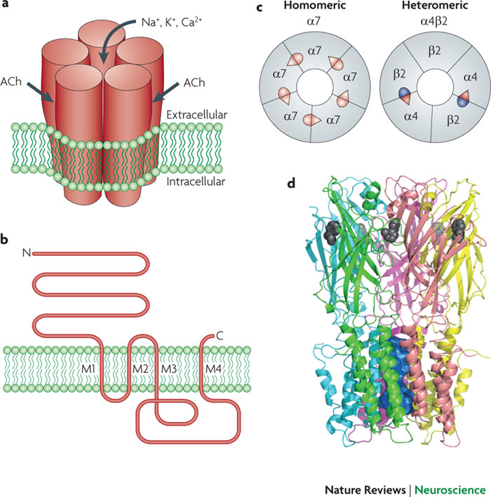
Notes:
From http://www.nature.com/nrn/journal/v11/n6/full/nrn2849.html

Slide 5
Gel Scramble Lecture 2
How to read a gel
Copyright William Grisham, Ph.D.
2014

Slide 6
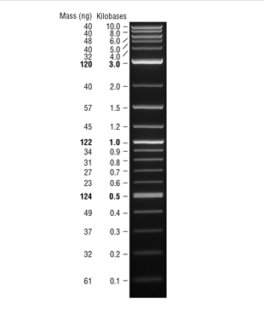
Key is the molecular
weight ladder

Slide 7
Smaller molecular
weights migrate
Further on gel

Slide 8
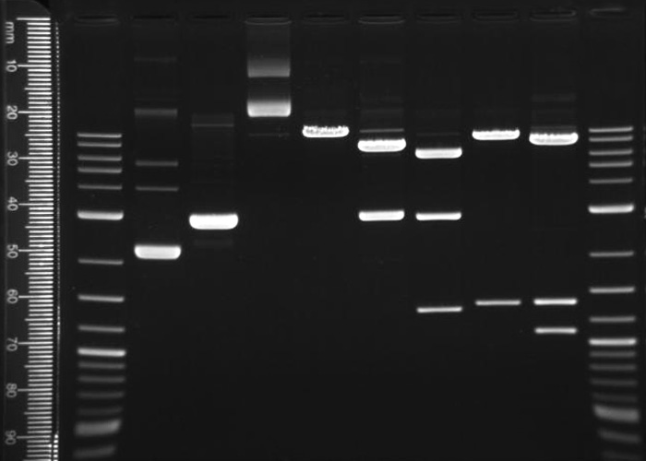

Slide 9
Can plot the migration
as a function of
kilobases if use the
Ruler.

Slide 10
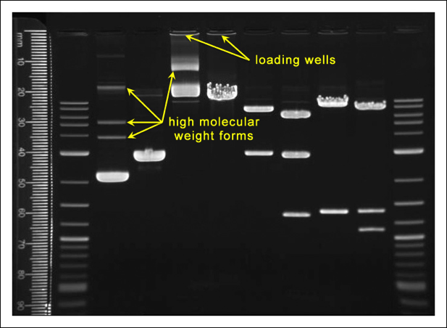

Slide 11
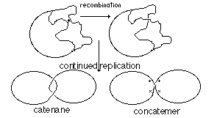
Notes:
From
http://bioinfosu.okstate.edu/MG/MGW3/i32131.gif

Slide 12
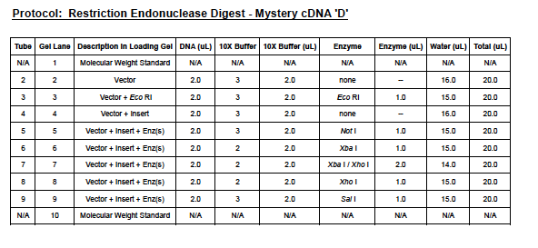

Slide 13
1
2
3
3.0 Kb
Should be 2961 Bp

Slide 14
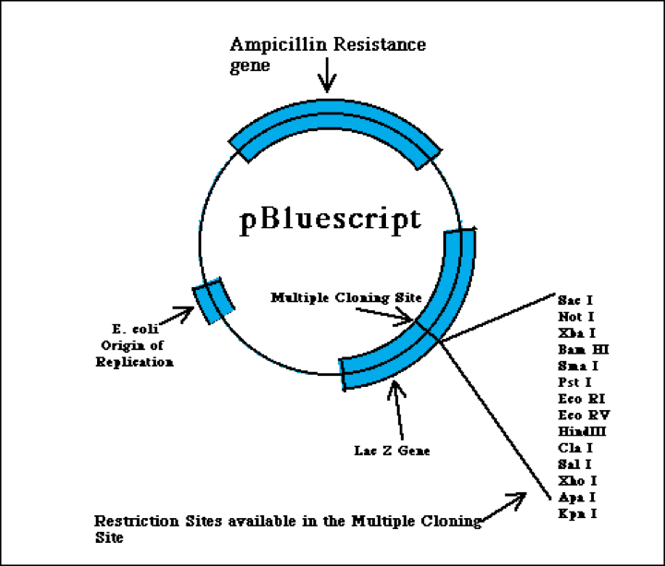
2961 Bp
Notes:
From
http://www.bio.davidson.edu/Courses/Molbio/MolStudents/spring2003/Keogh/plasmids.html#basicplasm

Slide 15
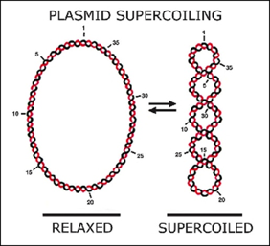
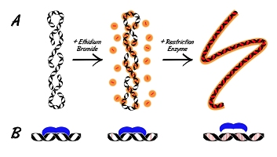
Notes:
Left image from http://rncnyc2004.blogspot.com/2007/12/direct-evidence-that-bioclocks-work-by.html
Right image from http://bitesizebio.s3.amazonaws.com/content/uploads/2011/04/EtBr-Rest-Enz_353x200.jpg

Slide 16
1
2
3
3.0 Kb
Should be 2961 Bp

Slide 18
2961 Bp
Notes:
From
http://www.bio.davidson.edu/Courses/Molbio/MolStudents/spring2003/Keogh/plasmids.html#basicplasm

Slide 19
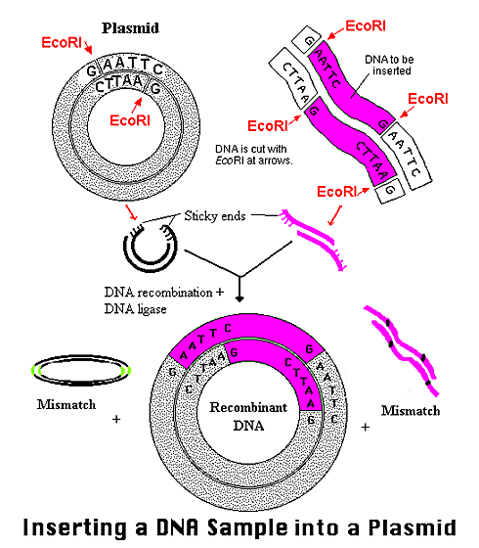
Notes:
From
http://www.bio.davidson.edu/Courses/Molbio/MolStudents/spring2003/Keogh/plasmids.html#basicplasm

Slide 20
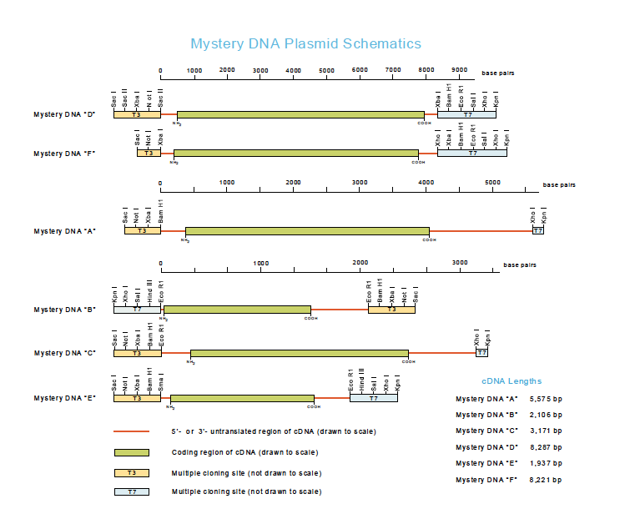
8288 Bp—got from sequence

Slide 21
bp
+
8288 bp
= 11,249 bp
Notes:
From
http://www.bio.davidson.edu/Courses/Molbio/MolStudents/spring2003/Keogh/plasmids.html#basicplasm

Slide 22
1
2
3
4
5
Offscale! But certainly
bigger than 10,000 bp
Should be 11,249 bp

Slide 23
Why would we put in lanes 1-4?
These are control lanes
Allow us to interpret unexpected results
  What if plasmid had no insert?
  What if reactions were not complete?
    Uncut plasmid with or without insert could be identified
  Sometimes want to “snip out” insert

Slide 24
1
2
3
4
5
Undigested plasmid
+ insert
Note raggedy edges

Slide 25
How to match protocols to gels
1) Separate on basis of size of plasmid+insert
2) Pattern of bands across lanes

Slide 26
Separating on basis of insert size
DNA A = 5,575 bp + 2,961 bp (insert) = 8,536 bp
DNA B = 2,106 bp + 2,961 bp = 5,067 bp
DNA C = 2,795 bp + 2,961 bp = 5,756 bp
DNA D = 8,287 bp + 2,961 bp = 11,248 bp
DNA E = 1,937 bp + 2,961 bp = 4,898 bp
DNA F = 8,221 bp + 2,961 bp = 11,182

Slide 27
Key is the molecular
weight ladder

Slide 28
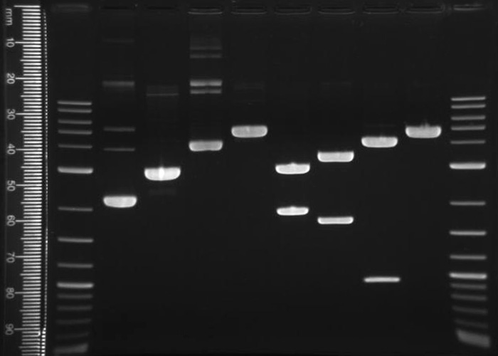

Slide 29
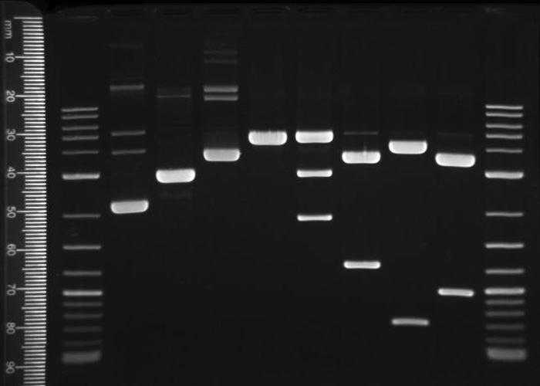
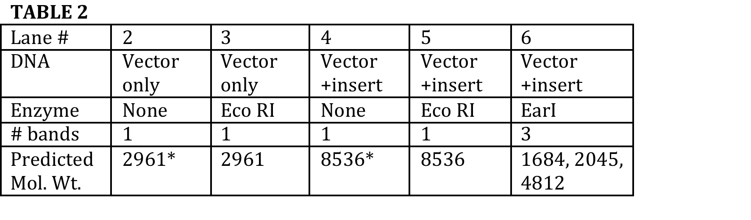
Can use the
predicted
pattern of
bands to
match protocols
to gels.
?

Slide 30
…and now—time for some challenges!

Slide 31
1
2
3
4
5
What’s up with lanes 4 & 5?

Slide 32
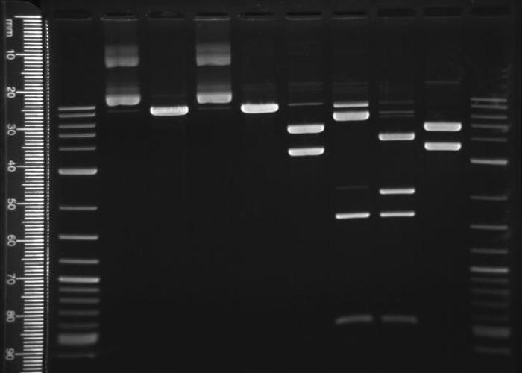
1
2
3
4
5
What’s wrong with this picture?
Note lanes 2-5

Slide 34
1
2
3
4
5
What’s wrong with this picture?
Note lanes 2-5

Slide 35
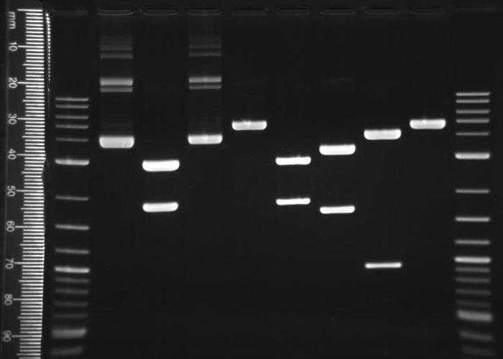
What’s wrong with this picture?
Note lanes 2-5

Slide 36
Summary
1) Learned how to use the molecular weight ladder.
2) Learned to discriminate high molecular weight forms such as concatamers.
3) Learned why plasmid cut and uncut as well as plasmid+insert cut and uncut are included in digests as controls.
4) Began to learn how to spot and explain unexpected data—including high mw bands, undigested DNA, and human error

