Slide 1
Unexplained data
William Grisham, Ph.D.
Copyright 2014

Slide 2
First Step
Wonky bands—really doesn’t make sense?
Check your numbers—get TA or Dr. G.

Slide 3
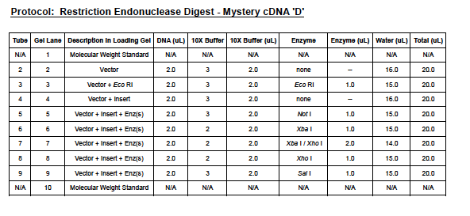

Slide 4
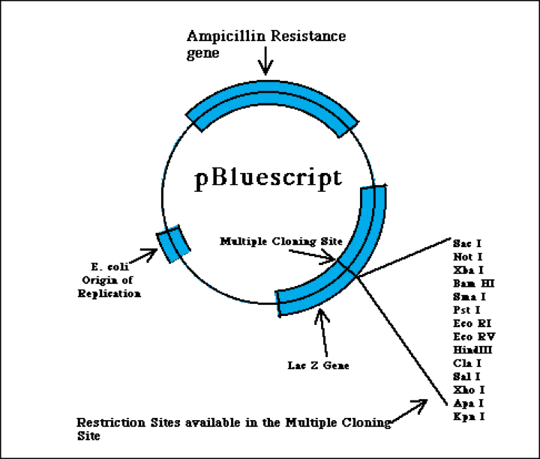
2961 Bp
Notes:
From
http://www.bio.davidson.edu/Courses/Molbio/MolStudents/spring2003/Keogh/plasmids.html#basicplasm

Slide 5
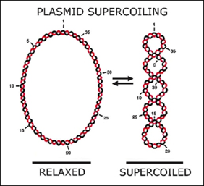
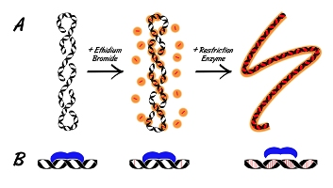
Notes:
Left image from http://rncnyc2004.blogspot.com/2007/12/direct-evidence-that-bioclocks-work-by.html
Right image from http://bitesizebio.s3.amazonaws.com/content/uploads/2011/04/EtBr-Rest-Enz_353x200.jpg

Slide 6
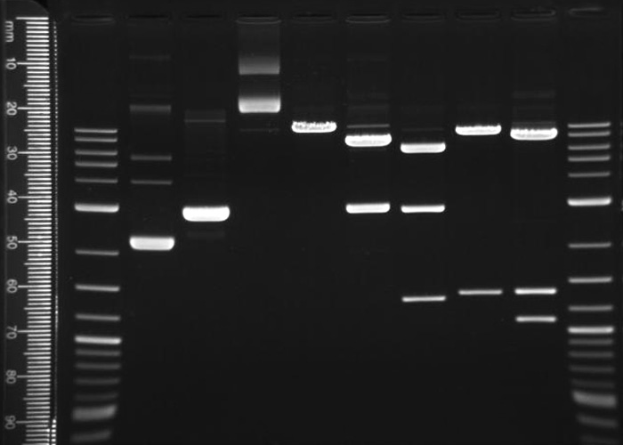
1
2
3
3.0 Kb
Should be 2961 Bp

Slide 7
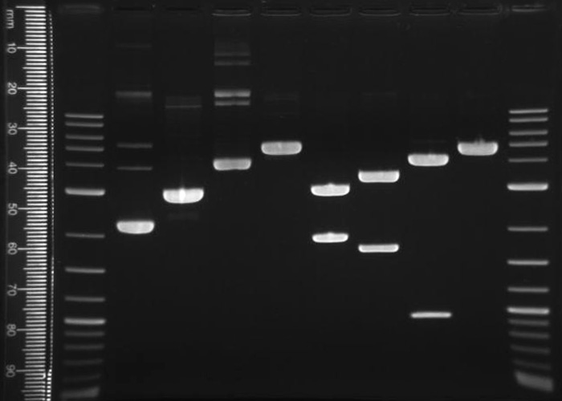
Note lanes 2-5—this is mostly
As it should be.

Slide 8
Unexpected data
1) High molecular weight forms lanes 2 & 4

Slide 9
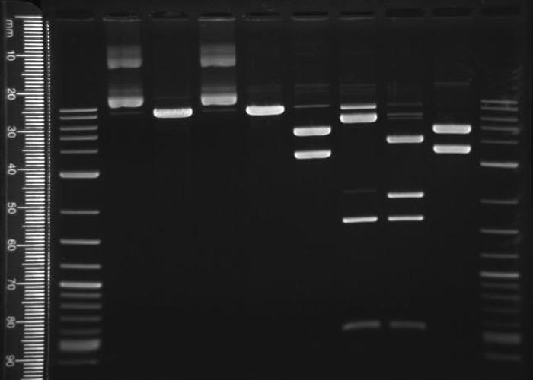
1
2
3
4
5
What’s wrong with this picture?
Note lanes 2-5

Slide 10
Unexpected data
1) High molecular weight forms lanes 2 & 4
2) Used the wrong DNA—used plasmid+ insert instead of insert alone—note which lanes.

Slide 11
1
2
3
4
5
What’s wrong with this picture?
Note lanes 6,7, & 8

Slide 12
1
2
3
4
5
6
7
8
Partial digest lanes 6,7, & 8

Slide 13
Unexpected data
1) High molecular weight forms lanes 2 & 4
2) Used the wrong DNA—used plasmid+ insert instead of insert alone.
3) Partial digest—bands equal to the plasmid+insert when there should be none.

Slide 14
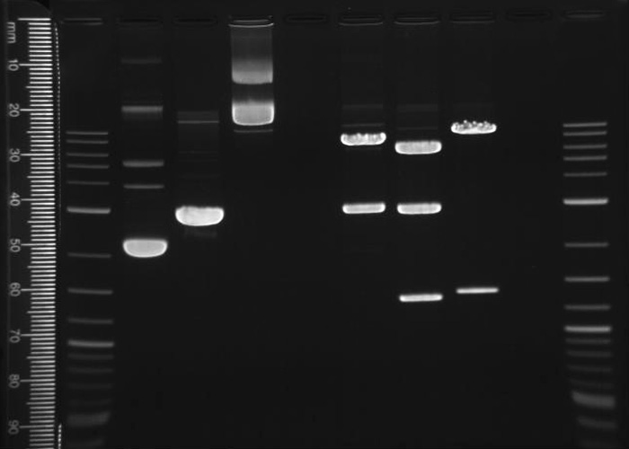

Slide 15
Look Ma, no DNA!

Slide 16
Unexpected data
1) High molecular weight forms lanes 2 & 4
2) Used the wrong DNA—used plasmid+ insert instead of insert alone.
3) Partial digest—bands equal to the plasmid+insert when there should be none.
4) Left out DNA

Slide 17
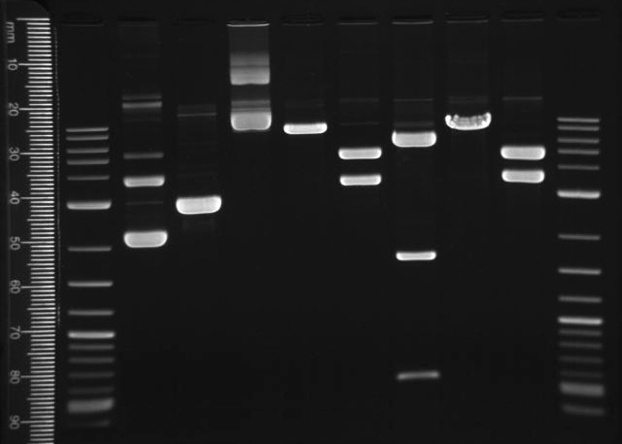
Double digest.
Was this DNA digested at
all?

Slide 18
Unexpected data
1) High molecular weight forms lanes 2 & 4
2) Used the wrong DNA—used plasmid+ insert instead of insert alone.
3) Partial digest—bands equal to the plasmid+insert when there should be none.
4) Left out DNA
5) Left out enzyme.

Slide 19
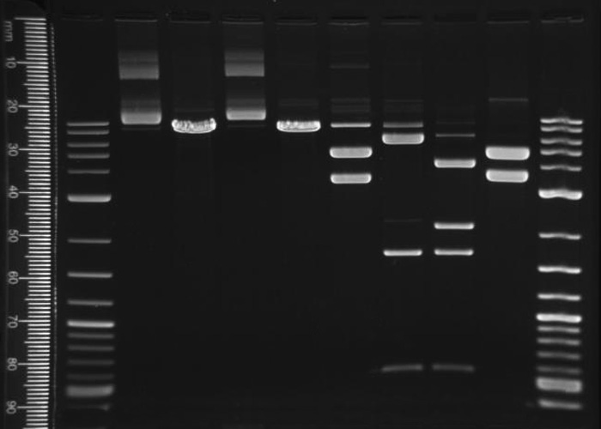

Slide 20
Overloaded DNA

Slide 21
Unexpected data
1) High molecular weight forms lanes 2 & 4
2) Used the wrong DNA—used plasmid+ insert instead of insert alone.
3) Partial digest—bands equal to the plasmid+insert when there should be none.
4) Left out DNA
5) Left out enzyme
6) Overloaded DNA

Slide 22
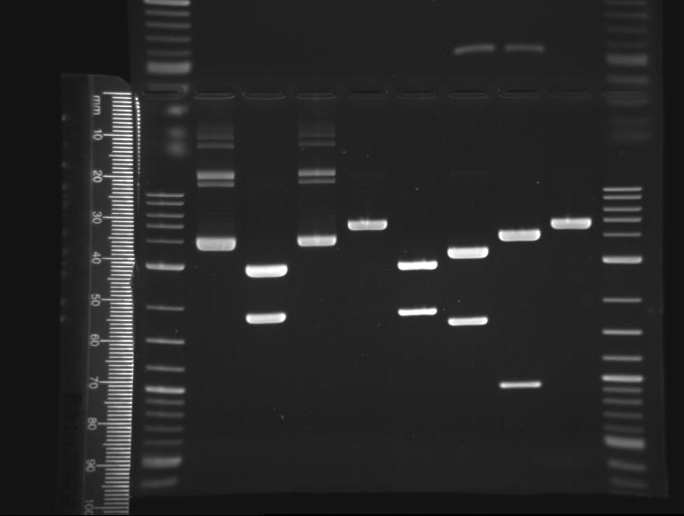
Ignore everything above the wells.

Slide 23
Ignore everything above the wells.
Should be linearized plasmid—
Matches lane 6.

Slide 24
Unexpected data
1) High molecular weight forms lanes 2 & 4
2) Used the wrong DNA—used plasmid+ insert instead of insert alone.
3) Partial digest—bands equal to the plasmid+insert when there should be none.
4) Left out DNA
5) Left out enzyme
6) Overloaded DNA
7) Humanoid error—swap? Sequel? Wrong reaction in the lane(s)

Slide 25
Ignore everything above the wells.
Small band below 300 bp was
predicted in lane 9.

Slide 26
Ignore everything above the wells.
Small band below 300 bp was
predicted—ran off gel.
500 bp

Slide 27
Unexpected data
1) High molecular weight forms lanes 2 & 4
2) Used the wrong DNA—used plasmid+ insert instead of insert alone.
3) Partial digest—bands equal to the plasmid+insert when there should be none.
4) Left out DNA
5) Left out enzyme--possibly
6) Overloaded DNA
7) Humanoid error—swap? Sequel? Wrong reaction in the lane(s)
8) Small bands may run off gel—check ladder to be sure.

Slide 28
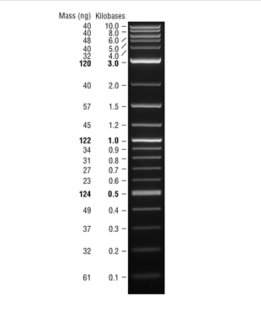
The MW Ladder is Your Friend

Slide 29
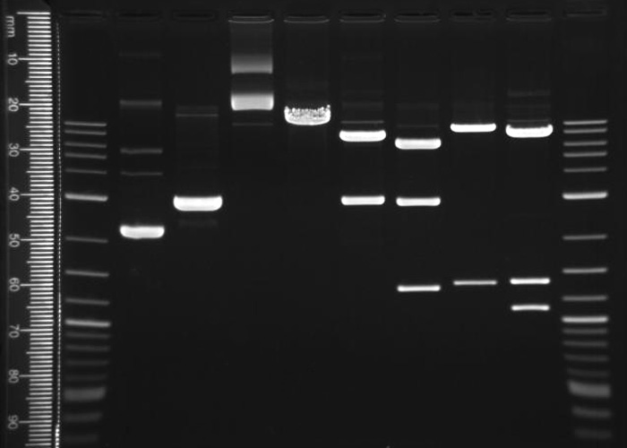
DNA sequence in Lane 6 predicts another large
band—enzyme IS present.

Slide 30
Unexpected Data
Methylated sites
  Might predict a band due but due to methylation, there is no cut.

Slide 31
Unexpected data
1) High molecular weight forms lanes 2 & 4
2) Used the wrong DNA—used plasmid+ insert instead of insert alone.
3) Partial digest—bands equal to the plasmid+insert when there should be none.
4) Left out DNA
5) Left out enzyme
6) Overloaded DNA
7) Humanoid error—swap? Sequel? Wrong reaction in the lane(s)
8) Small bands may run off gel—check ladder to be sure.
9) Methylation prevents cuts with enzyme—changes pattern of bands.

Slide 32
Unexpected data
1) High molecular weight forms
2) Used the wrong DNA—used plasmid+ insert instead of insert alone.
3) Partial digest—bands equal to the plasmid+insert when there should be none.
4) Left out DNA
5) Left out enzyme
6) Overloaded DNA
7) Humanoid error—swap? Sequel? Wrong reaction in the lane(s)
8) Small bands may run off gel—check ladder to be sure.
  If a small band expected, maybe left out enzyme
9) Methylation prevents cuts with enzyme—changes pattern of bands.

Slide 33
Pedagogical Goals
1) Enhanced critical thinking skills
2) Dealing with unexpected data
  50% of ALL experiments in science don’t “work”
  Having strategies to deal with unexpected data are important
    Unexpected data can reveal important discoveries
    Need to rule out alternative explanations first
    Explaining unexpected data can lead to good troubleshooting protocols

Slide 34
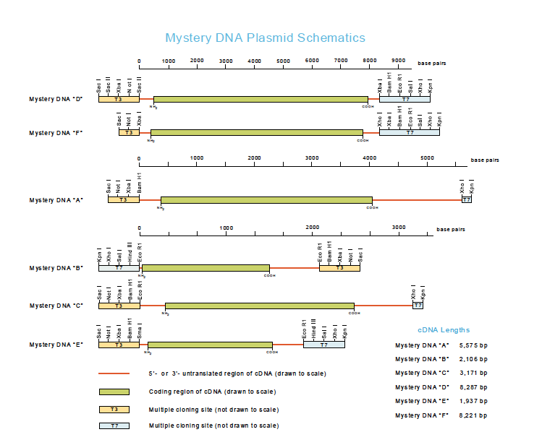
8287 Bp
2795

