Slide 1
Orientation to last lab of
Gel Scramble

Slide 2
Today’s tasks
1) Match protocols to gels.
2) Explain unexpected data.

Slide 3
How to match protocols to gels
1) Separate on basis of size of plasmid+insert
2) Pattern of bands across lanes

Slide 4
Separating on basis of insert size
DNA A = 5,575 bp + 2,961 bp (insert) = 8,536 bp
DNA B = 2,106 bp + 2,961 bp = 5,067 bp
DNA C = 2,795 bp + 2,961 bp = 5,756 bp
DNA D = 8,287 bp + 2,961 bp = 11,248 bp
DNA E = 1,937 bp + 2,961 bp = 4,898 bp
DNA F = 8,221 bp + 2,961 bp = 11,182

Slide 5
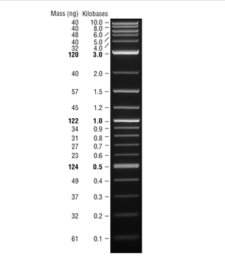
Key is the molecular
weight ladder

Slide 6
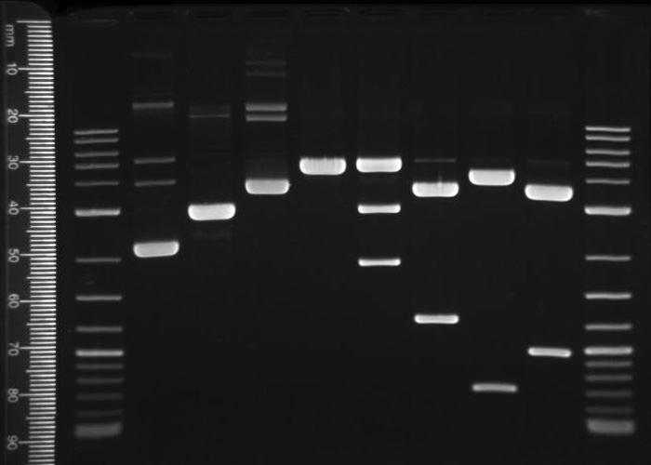
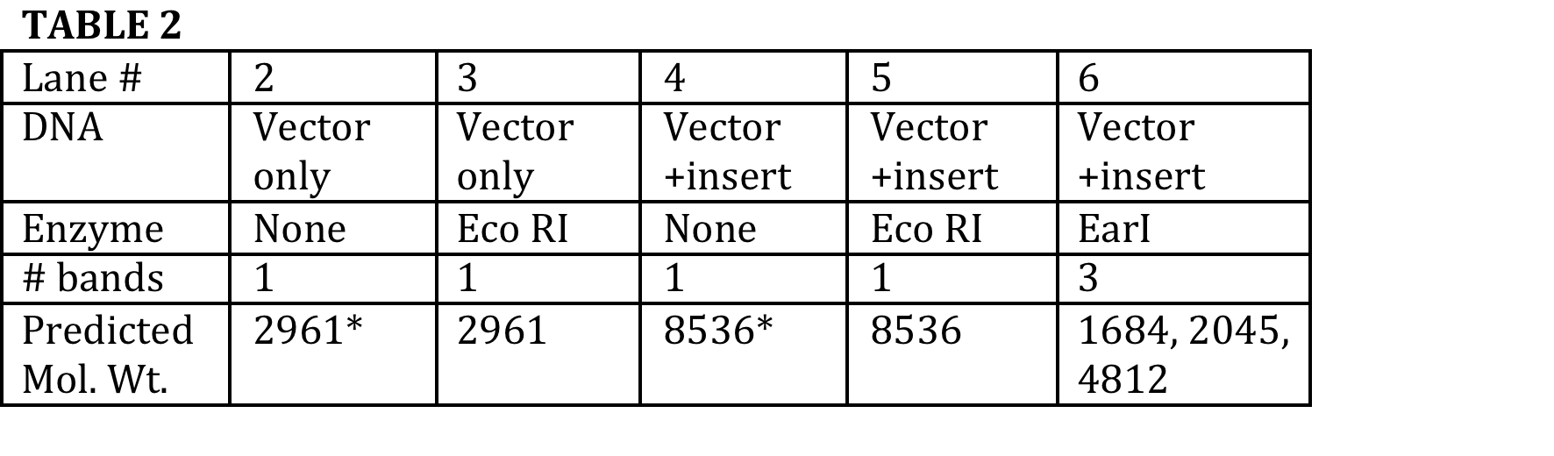
Can use the
predicted
pattern of
bands to
match protocols
to gels.
?

Slide 7
…and now—time for some challenges!

Slide 8
Unexplained data
William Grisham, Ph.D.
Copyright 2014

Slide 9
First Step
Wonky bands—really doesn’t make sense?
Check your numbers—get TA or Dr. G.

Slide 10
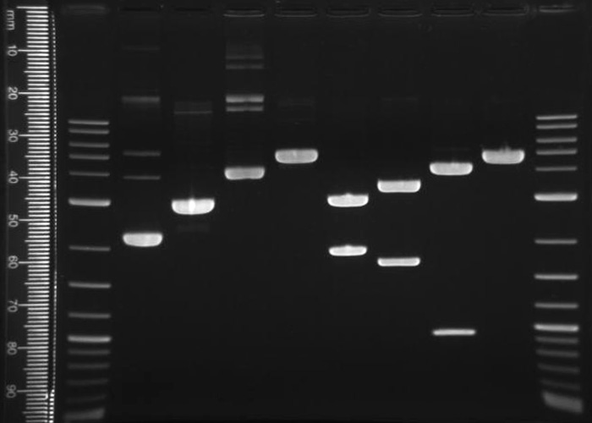

Slide 11
Unexpected data
1) High molecular weight forms
2) Used the wrong DNA—used plasmid+ insert instead of insert alone.
3) Partial digest—bands equal to the plasmid+insert when there should be none.
4) Left out DNA
5) Left out enzyme
6) Overloaded DNA
7) Humanoid error—swap? Sequel? Wrong reaction in the lane(s)
8) Small bands may run off gel—check ladder to be sure.
  If a small band expected, maybe left out enzyme
9) Methylation prevents cuts with enzyme—changes pattern of bands.
10) Linearized plasmid+insert travels further than uncut.

