Slide 1
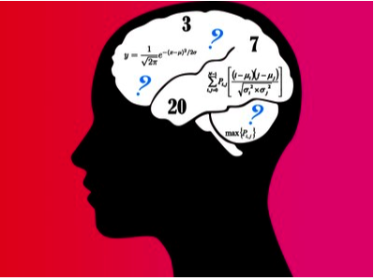
iNeuro
William Grisham
Dept. of Psychology and
Brain Research Institute
UCLA

Slide 2

iNeuro

Slide 3
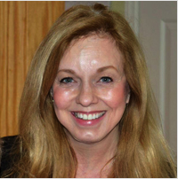
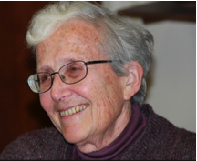
Diane Witt
Terry Woodin
http://sciencecareers.sciencemag.org/career_magazine/previous_issues/articles/2012_08_10/caredit.a1200091

Slide 4
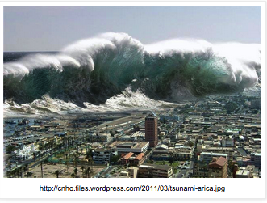

Slide 5
The cast— stakeholder groups
Managers and purveyors of data resources
Individuals involved in bioinformatics training
Library and information scientists
Computer scientists
Neuroscience educators

Slide 6
iNeuro Questions
1) Defining the Problem
2) Where are we now?
3) What skill sets are necessary for such a person?
4) What curriculum?—How taught?
5) Extant program as models?

Slide 7

Question # 1
Defining the Problem
Could this person
perform their duties
in ignorance
of the actual
content?
http://www.nickscrusade.org/the-griffin-was-based-on-a-real-creature/

Slide 8
Question # 1
Defining the Problem
Ingen!
Neuroscience
knowledge
uniformly
endorsed

Slide 9
Defining the Problem—educational aspects
Firm grounding in the discipline is necessary—need to understand the experiments to curate the data
Trainees need to understand scales and issues within scales are issues
TRANSdisciplinary training. Training needs to include data sharing and curation as a part of training

Slide 10
Defining the Problem—educational aspects
Data curation needs to be more central than a lab-by-lab basis
Not just curation and storage but also workflows are necessary process to be addressed
Database management where we can actually use it both for research and education
Curators should be advocates.
Notes:
NISBWEA

Slide 11
Defining the problem:
We need people who…
Understand neuroscience yet have highly interdisciplinary training
Understand Data sharing as well as curating
Understand centralized, large scale databases
Understand issues and problems of scales
Understand workflows

Slide 12
iNeuro Questions
1) Defining the Problem
2) Where are we now?
3) What skill sets are necessary for such a person?
4) What curriculum?—How taught?
5) Extant program as models?

Slide 13
iNeuro Questions
1) Defining the Problem
2) Where are we now?
3) What skill sets are necessary for such a person?
4) What curriculum?—How taught?
5) Extant program as models?

Slide 14
Question #2
Where are we now?
“Fishbowl” –sample from small scale provider
Every grad student is a “hacker” publishing on GitHub.
I hope that students come in with skills to wrangle data and code, and I do higher-order work.

Slide 15
Question #2
Where are we now?
“Fishbowl” Another lab
Labs are islands, silos.
Not a single skillset, continuous development of terminology and resources.
Have to be a computational and informational scientists as well as a “wet” scientist
There is a neuroinformatics and computational neuroscience training in the UK.

Slide 16
Question #2
Where are we now?
“Fishbowl” sample—super computer center
Many audiences, messages, and topics
Our job is to make sure everyone can use the tools.
Everything from a two-hour tutorial to a 10-day workshop, each focused on a specific audience, learning level, and set of tools.
Challenges: increase audience and broadening participation, increase topics (need improved teaching), increase variety of formats.

Slide 17
Question #2
Where are we now?
Fishbowl” sample—Allen Brain Institute
Different teams with different backgrounds have to work together We can’t have a single person curate data.
Multiple levels of work: Computer scientist writes algorithm for brain areas. Computational standpoint--graduate level training. Annotators (UG interns) come in and improve fidelity.
We partner with universities, hold hack-a-thons, etc., to train people.

Slide 18
iNeuro Questions
1) Defining the Problem
2) Where are we now?
3) What skill sets are necessary for such a person?
4) What curriculum?—How taught?
5) Extant program as models?

Slide 19
Where are we now?
--summary
Training presently scattershot
  Lots of on-the-job training
  Training seems largely ad hoc
  No extant formal training was frequently mentioned (only one program)
  Broadening participation in various senses was mentioned

Slide 20
iNeuro Questions
1) Defining the Problem
2) Where are we now?
3) What skill sets are necessary for such a person?
4) What curriculum?—How taught?
5) Extant program as models?

Slide 21

Question # 3 What skill sets are necessary for such a person?
Is this some sort of
beast that we have
never seen
before?
http://www.nickscrusade.org/the-griffin-was-based-on-a-real-creature/

Slide 22

Maybe we are talking about more than one beast???
Notes:
http://imgur.com/gallery/v8GRL

Slide 23
Another view—2 “beasts”
a researcher who develops new techniques of utility to advance the field
a technician who does data management and wrangling type activities

Slide 24

Maybe we are talking about three different types that we have never seen?
Notes:
http://www.fanpop.com/clubs/anjs-angels/images/30363055/title/fantasy-creatures-photo

Slide 25
Possibly this type of person should be three different people?
  Wrangler or “Plumber”: Analyst for the data or data manager at acquisition of data
  Computational Neuroscientist: User of data with more in-depth knowledge of discipline
  Curation Professional/Practitioner: (Data Steward?) Maintaining data for long-term in a disciplinary repository

Slide 26

Data Steward
Wikipedia: Stewardship is an ethic that embodies the responsible planning and management of resources.
Notes:
http://lotr.wikia.com/wiki/Denethor_II
Data Steward of Gondor

Slide 27
Opportunities:
An interesting idea
Embedding a iNeuro data steward within a lab in large scale efforts
In smaller scale efforts, have an iNeuro data steward embedded in a department or school
This person wrangles the data, makes it shareable, uploads it to extant repositories, etc.

Slide 28
iNeuro Questions
1) Defining the Problem
2) Where are we now?
3) What skill sets are necessary for such a person?
4) What curriculum?—How taught?
5) Extant program as models?

Slide 29
Question #3
Skills needed
Neuroscience background
  Fundamental Principles
  Expt. Designs/methods/tools

Slide 30
Question #3
Skills needed
  Technical/computing/analytic
    Principles of computing & High performance computing techniques
    Data visualization and communication of results
    Programming literacies (understanding basic code)
    Knowledge of database design
    Web services and data transfer methods (web technologies, such as APIs)
Notes:
Application Programming interface

Slide 31
Question #3
Skills needed
  Library Science
    Informatics/Data Science
    Data Formats, Standards, Data Wrangling
    Vocabularies, Lexicons, Ontologies, Semantics, Interoperability
    Data LifeCycle Management
    Existing Data, Information and Knowledge Resources
    Documentation of workflows and protocols
    Data annotation
    Metadata

Slide 32
Question #3
Skills needed
Quantitative
  Data Analysis
  Machine Learning
  Programming/Scripting
  Probability and Statistics, Univariate, multivariate
  Signal Processing
  Software Applications (Imaging, etc.)
  Standardized Workflows

Slide 33
Question #3
Skills needed
Miscellanea
  Management Skills
  Data Ethics:
    Understanding and appreciation of reproducibility issues in data
    Data licensing and attribution techniques
    Privacy and legal responsibilities of data (eg. HIPPA)
      National/International Data Sharing

Slide 34
iNeuro Questions
1) Defining the Problem
2) Where are we now?
3) What skill sets are necessary for such a person?
4) What curriculum?—How taught?
5) Extant program as models?

Slide 35
Question #3
Skills needed
Neuroscience
Regulatory
environment
Informatics
Data analysis

Slide 36
iNeuro Questions
1) Defining the Problem
2) Where are we now?
3) What skill sets are necessary for such a person?
4) What curriculum?—How taught?
5) Extant program as models?

Slide 37
Question #4
What curriculum?
Participants often suggested a two level program:
1) Bachelor’s & Master’s
OR
Master’s & PhD.

Slide 38
Question #4
Composite Suggested Undergrad curriculum
Computing (grounding in theory): Principles of database design, Web programming and data structures, Script writing
Statistics
Research methodology: design, ethics, intellectual property
Introduction to neuroscience
Independent study research course (hands on)

Slide 39
Question #4
One Suggested Master’s curriculum
Sampling of neuroscience: methodologies and research techniques:Tools for data collection, languages, scripting, & analysis Can you go from math/physics/engineering to this training?
Library and Information Science coursework: Metadata, Data management
Computer Science coursework: Machine learning, Data mining
Data visualization and communication
Team science: Interdisciplinary open-ended, challenge-based project

Slide 40
Question #4
Another suggested Grad curriculum
Math: Probability and Statistics, Linear Algebra
Machine Learning, Information Tech
Interdisciplinary Teams, Workshops
Systems/ network Linking Data Methods with Computational Methods
Hierarchal Modeling as a means to organize the scientific questions and the data
Data Discovery complemented by neuroscience laboratory experimental validation

Slide 41

Hands-on instructional practices
consistently advocated

Slide 42




Slide 43
iNeuro Questions
1) Defining the Problem
2) Where are we now?
3) What skill sets are necessary for such a person?
4) What curriculum?—How taught?
5) Extant program as models?

Slide 44
Question #4
Curriculum--summary
Hands-on, genuine projects frequently mentioned—mathematics necessary
Good consensus on undergraduate curriculum
Graduate curricula had more diverse suggestions
  Perhaps Master’s and Doctoral level different
  Different for different career paths in this realm

Slide 45
iNeuro Questions
1) Defining the Problem
2) Where are we now?
3) What skill sets are necessary for such a person?
4) What curriculum?—How taught?
5) Extant program as models?

Slide 46
Question #5
Extant program as models?
Can we use extant programs as models for those that we hope to build?
Ja
Ingen
Kanske

Slide 47
Question #5
Extant program as models?
Ingen:
NEW: Both in terms of marketing to students and in terms of approach to teaching—hands on methods!
Must be distinct from Intro Neuroscience and distinct from Intro CS.

Slide 48
Question #5
Extant program as models?
Kanske
Elements of existing curricula at our universities that could be used to populate existing programs.
  Cut-and-paste courses: Bring masters-level courses together from across disciplines (database design)
  Workforce: Bring library science professions in to classes to teach data curation, preservation.

Slide 49
Question #5
Extant program as models?
Woods Hole model: data acquisition, Quality Control, data sharing, analysis workflow
Jamboree model: https://sites.google.com/site/neuroinformaticsjamboree/
Software Carpentry: http://software-carpentry.org
Many other short courses (e.g. at SfN)

Slide 50
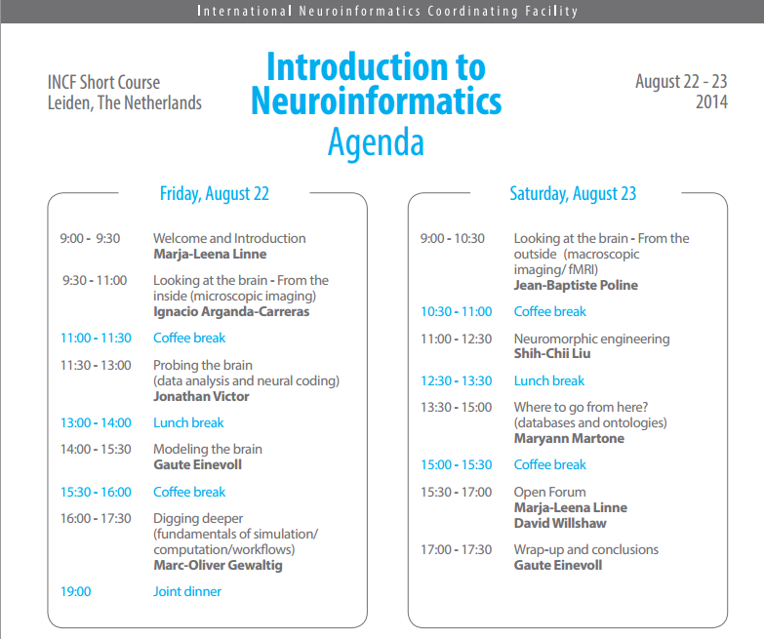

Slide 51

Question #5
Extant program as models?
JA
Neuroinformatics training Doctoral Training U of Edinburgh
Check imperial college London, also Poland—check more broadly

Slide 52
iNeuro Questions
1) Defining the Problem
2) Where are we now?
3) What skill sets are necessary for such a person?
4) What curriculum?—How taught?
5) Extant program as models?

Slide 53
Strengths of Current Position
Consensus on list of skills.
New job opportunities – marketable quantitative skills.
There are some incentives to share data (funding and journal mandates)
Students, the general public, and funding agencies are interested
Tremendous cost to inaction

Slide 54
Barriers to Implementation
Action plan not well articulated
Curator & steward jobs don’t yet exist
Potential Faculties may not have requisite skills
  Buy-in from administrators
  How will resources be sustained beyond initial build / contribution?
  What buy-in from societies?
  Evaluation of programs—how to do it?

Slide 55
Action Plan
Short term
iNeuro Workshop itself helped propagate ideas—participants more aware of training programs
Proposed symposium at SfN
White Paper in progress—will go to CNDP, NSF, OSTP, iNeuro participants
Anybody else who wants it or may be interested

Slide 56
Action Plan
Intermediate
Workshops—INCF Model, SfN Shortcourses
Summer Courses—more in-depth

Slide 57
Action Plan—long term
INCF
Field of Dreams:
    Build it and they will come
    SfN short course—could be cost neutral—symposium first?
More in-depth? Longer? Instead of a short course—a long course?
  Moocs?

Slide 58
Action Plan--
Long term
Role of funding agencies?
  May help establish but there needs to be a sustainability plan on part of institution
    Can’t depend on indefinite
    funding

Slide 59
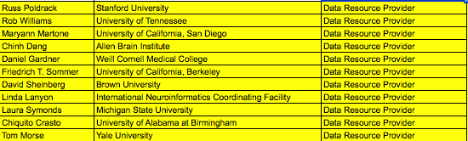

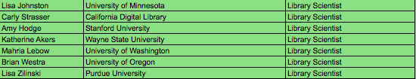
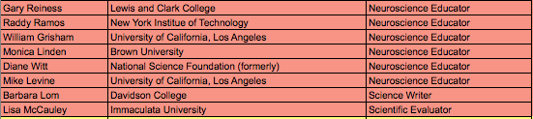



Slide 60
iNeuro Questions
1) Defining the Problem
2) Where are we now?
3) What skill sets are necessary for such a person?
4) What curriculum?—How taught?
5) Extant program as models?

